Slide 1

Advanced x86: BIOS and System Management Mode Internals SMM & Caching
Xeno Kovah && Corey Kallenberg
LegbaCore, LLC

Slide 2
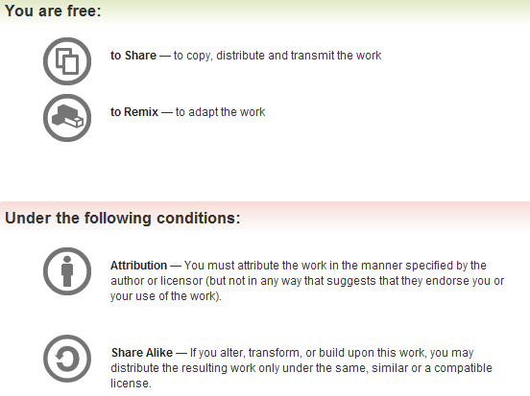
All materials are licensed under a Creative Commons “Share Alike” license.
http://creativecommons.org/licenses/by-sa/3.0/
Attribution condition: You must indicate that derivative work
"Is derived from John Butterworth & Xeno Kovah’s ’Advanced Intel x86: BIOS and SMM’ class posted at http://opensecuritytraining.info/IntroBIOS.html”
Notes:
Attribution condition: You must indicate that derivative work
"Is derived from John Butterworth & Xeno Kovah’s ’Advanced Intel x86: BIOS and SMM’ class posted at http://opensecuritytraining.info/IntroBIOS.html”

Slide 3
SMRAM and Caching

Slide 4
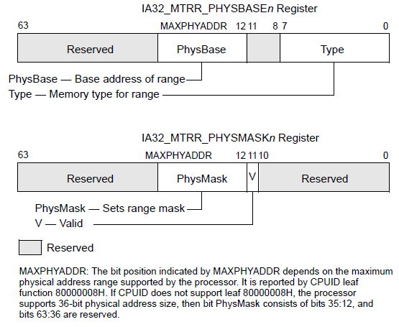
Cache Basics
From Intel Vol. 3. Ch. "Memory Cache Control"
Temporary storage located on the CPU
Accesses to data/instructions in cache are much faster than those to physical memory
Caching is available in all operating modes, including SMM
Caching type for a physical memory range is defined in Memory-Type Range Registers (MTRRs)
MTRRs are a type of MSR (Model-Specific Register) that can be set to specify the type of CPU caching for ranges of physical memory
Typically configured by BIOS but can also be configured by the operating system as needed
Notes:
***This is not going to be a discussion on CPU architecture, for details on caching I recommend 3 sources:
Both the Intel and AMD Optimization Reference Manuals, and Agner Fog’s optimization references

Slide 5
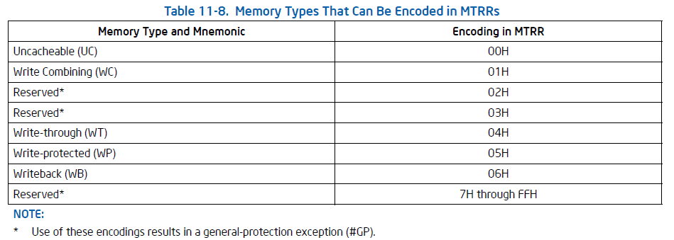
Memory Caching Types
From Intel Vol. 3. Ch. "Memory Cache Control"
Physical memory ranges can be defined as having one of these types of caching properties
The only one we’ll discuss is the one that was the subject of the dual discovery by Duflot et al. and then later Wojtczuck et al.
Getting into SMRAM: SMM Reloaded, https://cansecwest.com/csw09/csw09-duflot.pdf
Attacking Memory via Intel CPU Cache Poisoning, http://invisiblethingslab.com/resources/misc09/smm_cache_fun.pdf
The attack is brilliant in its simplicity
Notes:
Todo, cite Loic's paper since they technically found it first

Slide 6
Write-back (WB)
The point of Write-back caching is to reduce the amount of bus traffic between the processor and memory
Reads come from cache lines on cache hits
Writes are performed in the cache and not immediately written/flushed to memory
Both read and write misses cause cache fills
Modified CPU cache lines are written back (write-back) to memory at a later time*
Simply put, reading/writing from/to a memory region that uses write-back caching will initially fill a line in the CPU cache
Subsequent reads/writes from/to that address will be from/to cache instead of memory
Until the processor writes-back that cache to memory*
*Read the Intel Software Developers Guide Volume 3

Slide 7
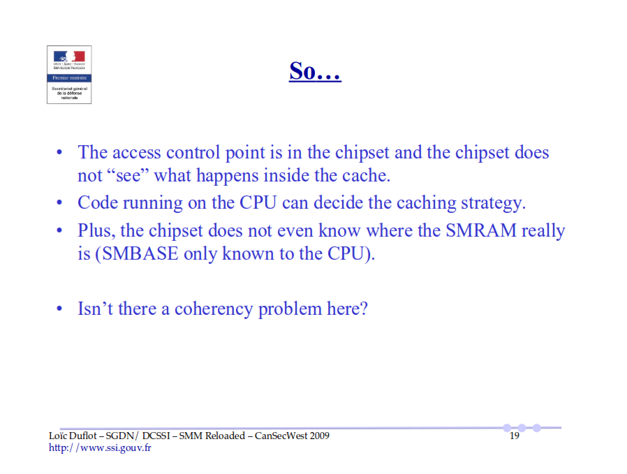
https://cansecwest.com/csw09/csw09-duflot.pdf
(D_LCK bit)

Slide 8
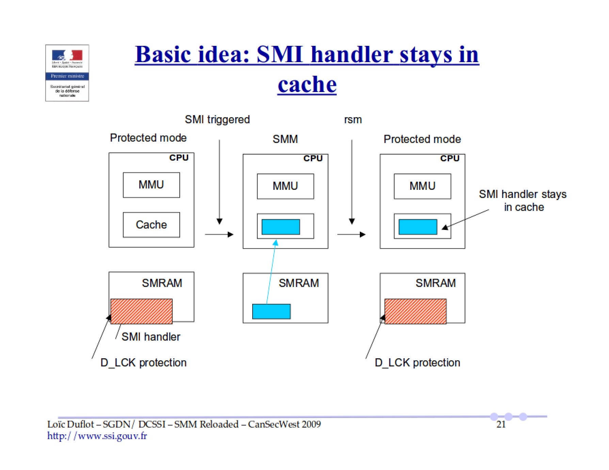
https://cansecwest.com/csw09/csw09-duflot.pdf

Slide 9
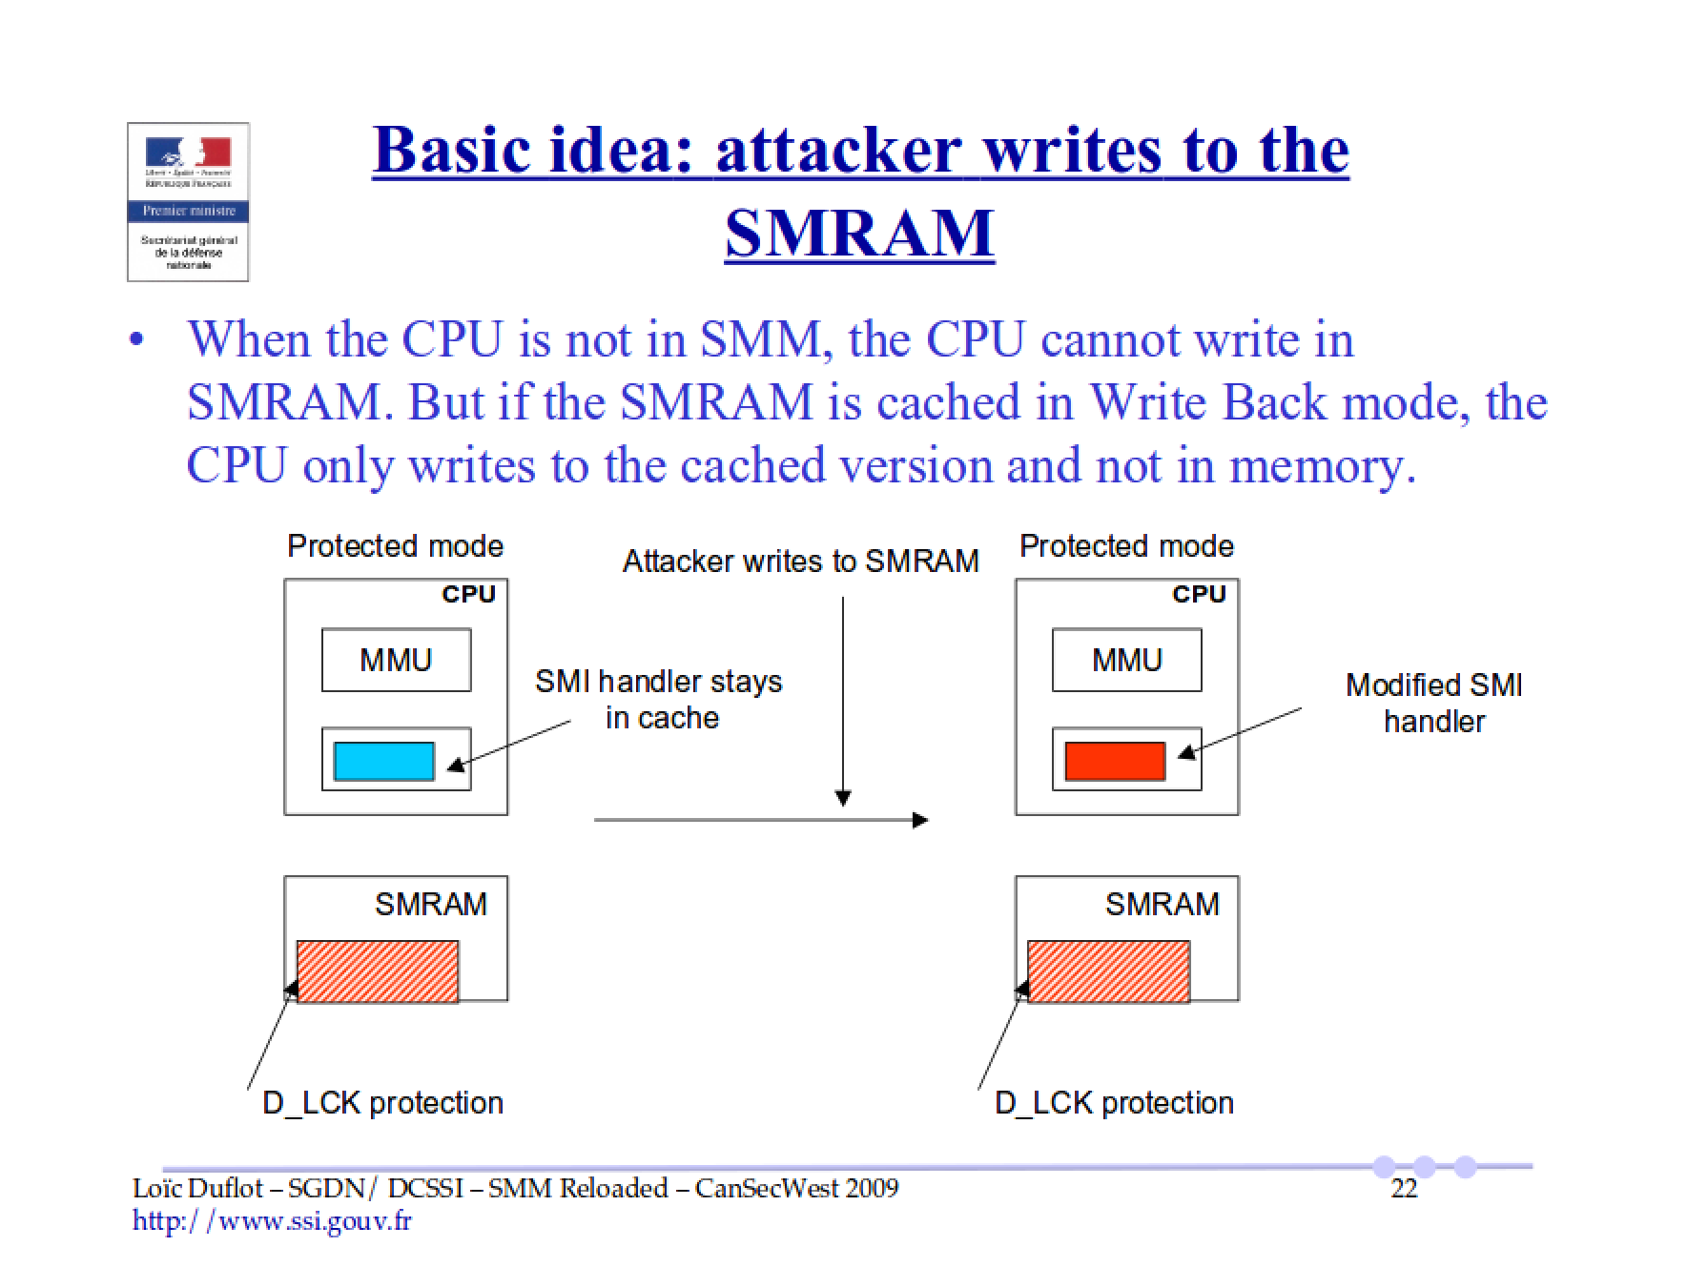
https://cansecwest.com/csw09/csw09-duflot.pdf

Slide 10
The fix: SMRR
The preceding is a great example of how security researchers can influence industry for the better. Damn fine job.
System-Management Range Register (SMRR) was introduced in Intel’s x64 architecture*
Provides a PHYSBASE/PHYSMASK pair just like MTRRs
Prevents the kind of attack that we just saw in the preceding example
SMRR restricts access to the address range defined in the SMRR registers
Defines the memory type (caching) for the SMRAM range
SMRRs can be written to only when the processor is in SMM
SMRR takes priority over MTRR in case of overlapping ranges
* This is one of the only architecture-dependent security mechanisms. So far up to this point all has been x32/x64 agnostic

Slide 11
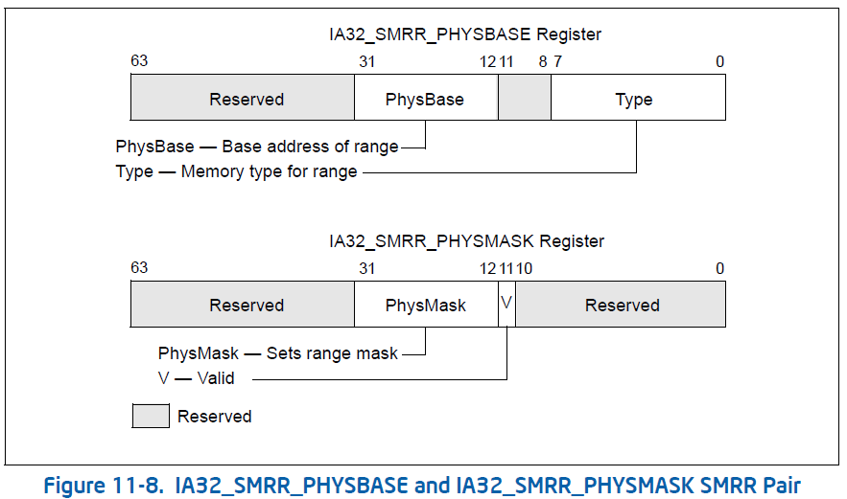
SMRR
When the processor is in SMM:
Memory accesses to this range will use the memory type defined in SMRR_PHYSBASE
When the processor is not in SMM:
Memory reads return a fixed value (0xFF in my experience)
Memory writes are ignored
Memory type is Uncacheable

Slide 12
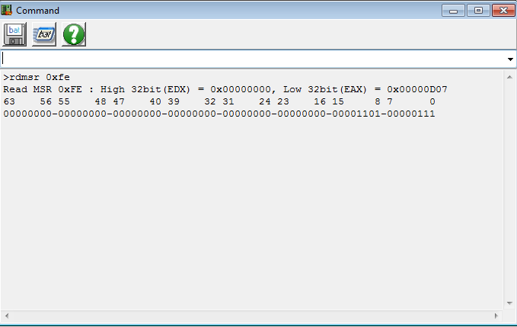
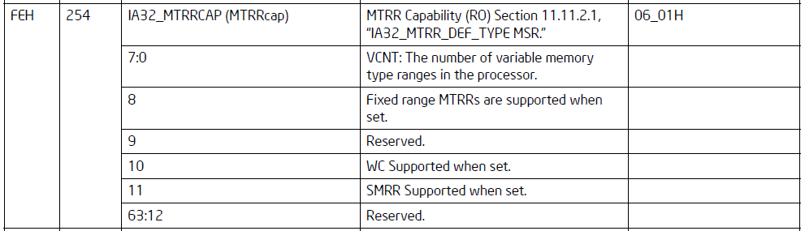
Verify SMRR Support: IA32_MTRRCAP
SMRR is supported on a system if bit 11 in the IA32_MTRRCAP MSR is set
Verify next that it is being used

Slide 13
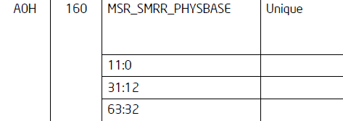
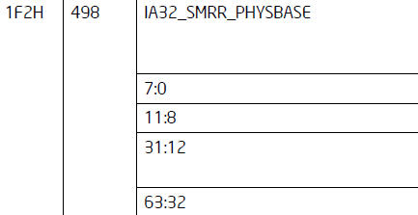
SMRR MSR Number
For the reference E6400 (Core2Duo)
If you try to read the SMRR of your system, be sure to verify its location using the developers guide (MSR chapter)
The MSR register addresses are non "architectural" and will therefore differ between architectures
That’s why they are called Model-Specific Registers
RW-E does not appear to handle exceptions well since reading the wrong MSR will crash your system
As of latest version

Slide 14
Homework heads up
Find the value of SMRR_PHYSBASE for your particular hardware

